Slide 1


1 - Keys of Pixel Art
Pixel Art Club
Topic 1 - Basics
L1- Keys of Pixel Art
Pixel Art Club

Slide 2
What is Pixel Art
Pixel Art Club
Topic 1 - Basics
L1- Keys of Pixel Art
From Mario to Forager, it is a certain type of art that brings home an old, retro feel to games and sometimes packaging.
Comprised of little squares, it is an artform that has no limits. It is an infinite canvas, and the limit is only your drive size!

Slide 3
What will you learn?
Pixel Art Club
Topic 1 - Basics
L1- Keys of Pixel Art
In this club, you will learn many things; some of the key aspects are:
Proportions
Animation (Stretch frames, onions)
Basic & Intermediate art theory
How to design characters for different settings
This all builds up to where you will design your own character and enemies and get to play and take home your own personalised game.

Slide 4
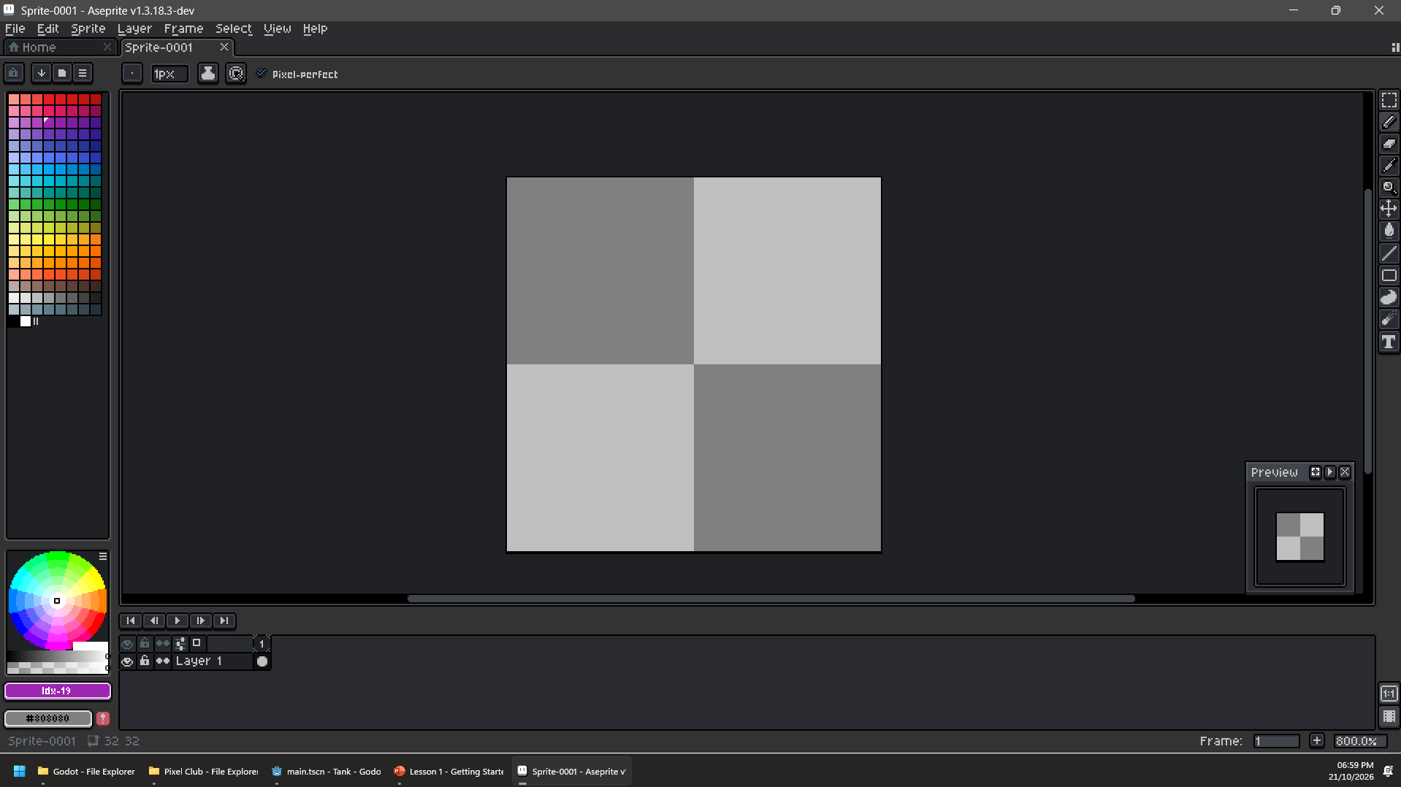
Getting Started – Layout
Pixel Art Club
Topic 1 - Basics
L1- Keys of Pixel Art
The Colour Palette. This is your toolbox for every colour you may ever need.
The Toolbar. Everything you will ever need to make art.
The Colour Selector. If a colour in the colour palette is not doing what you want it to, make it here!
Preview Pane. Small, but powerful. Lets you see your sprite at any size without having to move the view.
The Animation Panel. If you are animating, this is where the frames would appear.
If you want dark mode, put your hand up now!
Notes:
Edit > Preferences > General > Theme Mode: Light/Dark

Slide 5
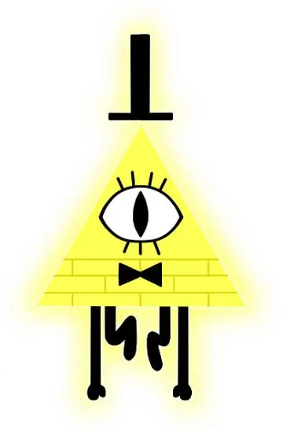

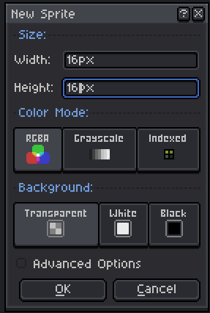

How to – Basic Shapes
Pixel Art Club
Topic 1 - Basics
L1- Keys of Pixel Art
If you are stuck for inspiration, try making Bill Cypher!
Click File > New, and open, in the “Width” & “Height” segment, choose 16 for both values. Leave the rest as they are.
Remember to use your tools!
Click on the Page Icon in the Colour Palette and choose a palette that has lots of varying colours, I prefer to use “Google UI”.
Draw a small character, the design is up to you, remember you can change brush size and colour.

Slide 6
It looks good, but
SOMETHING FEELS… OFF!
What do you think it could be?
Pixel Art Club
Topic 1 - Basics
L1- Keys of Pixel Art

Slide 7
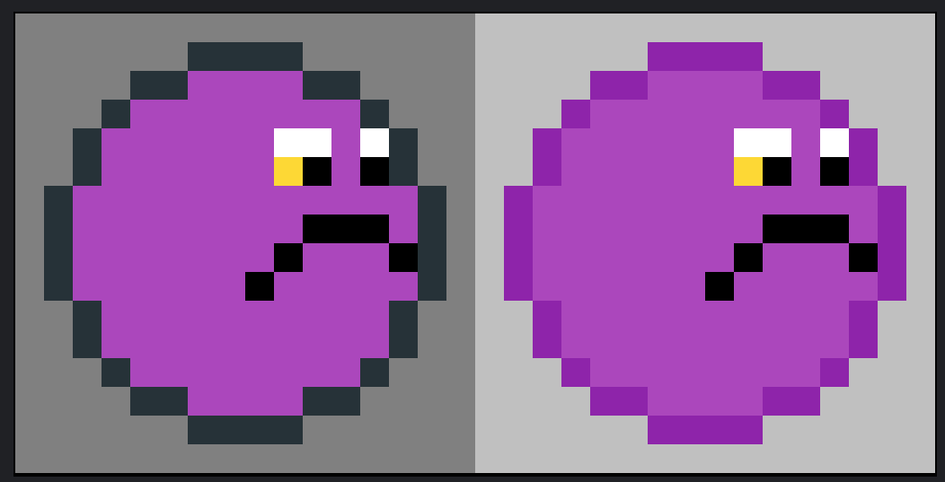
Examples - Issues
Which of these 2 looks better?
Votes:
Votes:

Slide 8
What’s the trick?
Unless you are going for contrast, make the outline of your character a bolder or lighter colour of the overall scheme, especially for multi-sprite projects.

